Slide 1
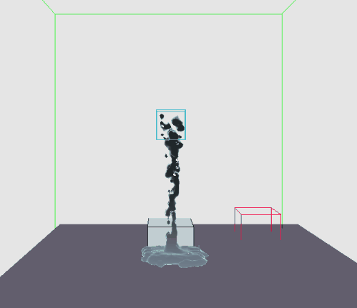
BREAKPOINT
Daniel Gerhardt
Dineth Meegoda
Matt Schwartz
Zixiao (Steve) Wang

Slide 2
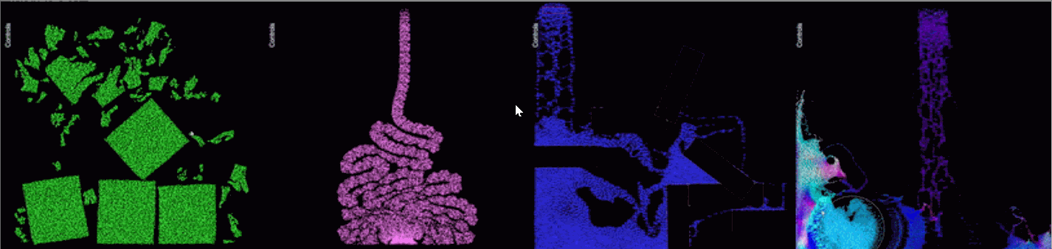
Position Based Material Point Method
Current standard is MPM
Easily implemented, can add multiple material types, not stable
Developed by EA’s research division
PBMPM modifies MPM
Semi-implicit compliant constraint
Stable at any time step
Not a complex addition to MPM
Our work moved the simulation to 3D on the GPU in a custom DX12 engine
Gif from https://github.com/electronicarts/pbmpm

Slide 3
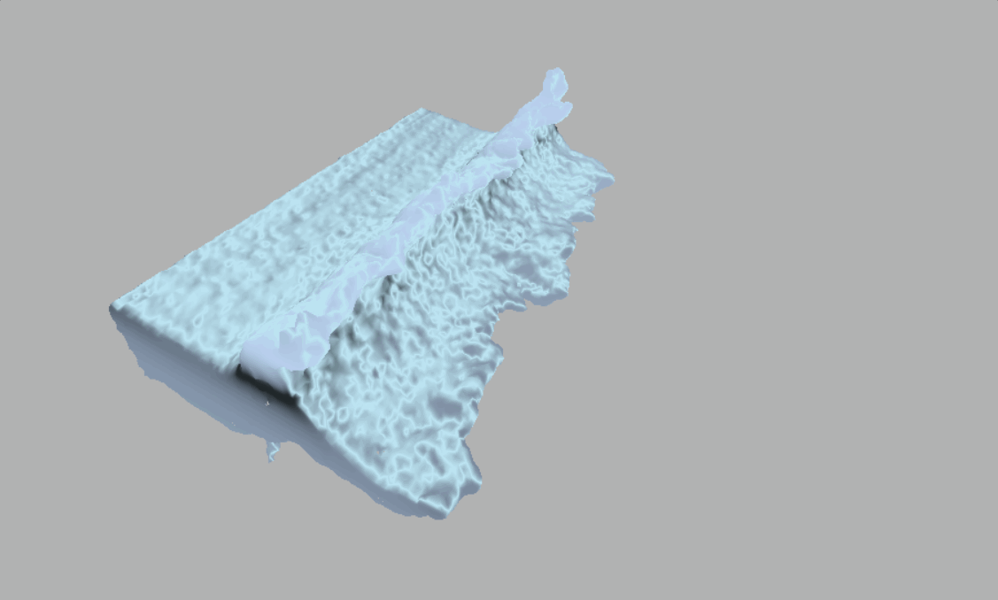
Fluid Surface Construction
Based on technique from Nishidate et al.

Slide 4
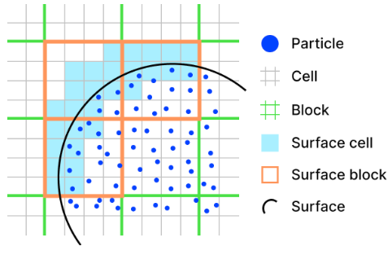
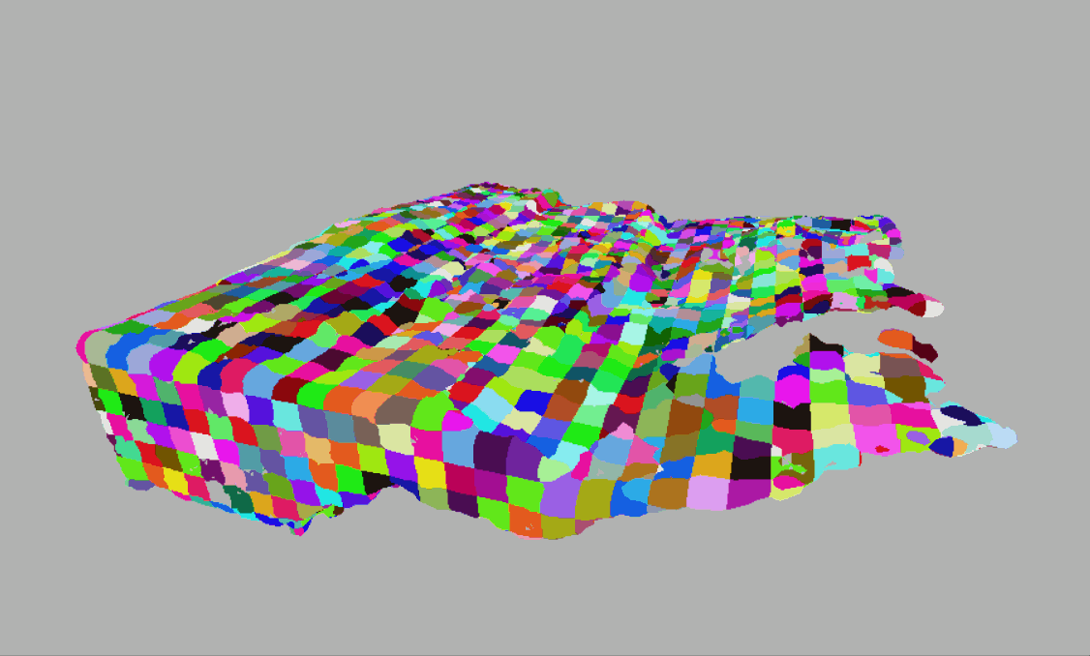
Bilevel Grid and Mesh shading
Nishidate et al.

Slide 5
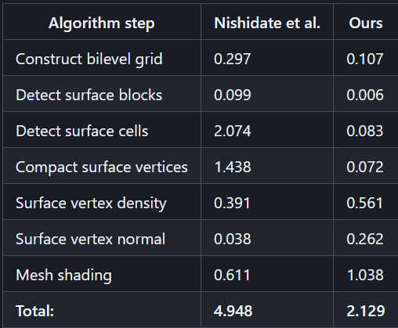
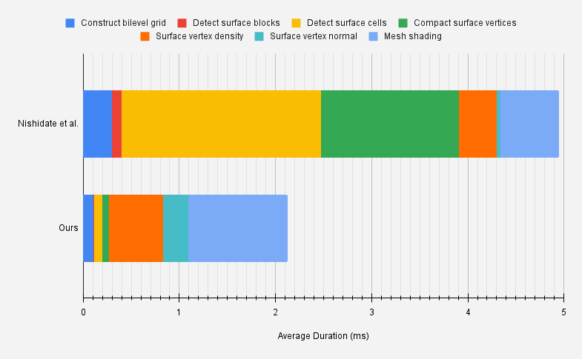
Mesh Shading Performance
(Duration measured in milliseconds,
averaged over 1,000 frames)

Slide 6
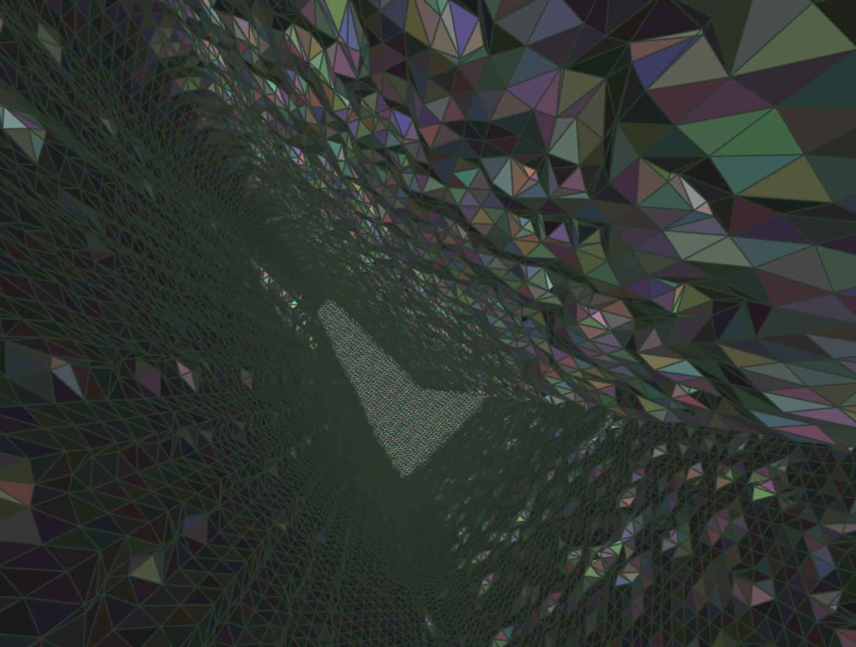
What’s Next?
Shared memory optimizations for 3D
DirectX Limitations
Optimizing mesh shader
Integrating into a real environment with complex objects
Adding and ensuring stability of materials

Slide 7






Daniel Gerhardt
danieljgerhardt@gmail.com
https://www.danieljgerhardt.com
Matt Schwartz
📧 Email
LinkedIn
Website
Dineth Meegoda
https://dinethmeegoda.com/
dinethmeegoda@gmail.com
Zixiao Wang
https://www.linkedin.com/in/zixiao-wang-826a5a255/
wangzx2023master@gmail.com

